Slide 1
Considering what a Local Nature Recovery Strategy for Surrey might mean for us in Buckland

Slide 2
Biodiversity (Biological Diversity)
Biodiversity in UK is declining
41% of UK species have decreased in abundance and average species population has fallen by 13% (State of Nature, 2019)
80% land intensively managed for food production (Office for National Statistics, 2019)
Surrey mirrors this trend – evidence suggests downtrend to biodiversity is faster

Slide 3
Legislation
The Environment Act 2021 (EA2021) came into effect on 1st Jan 2024
EA2021 requires a Nature Recovery Strategy to be in place for every parcel of land in England
A Local Nature Recovery Strategy (LNRS) must: -
Agree priorities for nature recovery
Map the most valuable existing habitats for nature
Map specific proposals for creating or improving habitat for nature and wider environmental goals
Surrey County Council’s (SCC’s) Chief Ecologist (with Surrey Nature Partnership) is preparing Surrey’s LNRS
Consultation on draft strategy by end 2024
1st report to UK Gov due by end Jan 2026

Slide 4
Legislation
Biodiversity Net Gain (BNG) is an approach introduced under EA2021 to ensure that developments and land management leave the natural environment in a better that it was beforehand
In England BNG is mandatory from 12th Feb 2024
Biodiversity uplift of at least 10% is mandated
The MVDC emerging local plan supports a target of 20% BNG

Slide 5
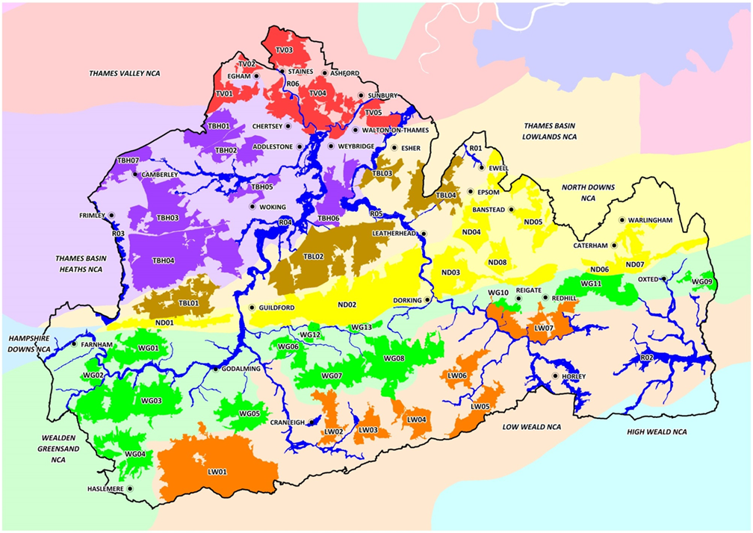
Biodiversity Opportunity Areas (BOAs)
BOA’s are expected to remain central to Surrey’s Nature Recovery Strategy (SNRS)
SNRS will therefore benefit from and build on work completed over the last 10 – 15 years
As will finding ways to enhance and create links between BOA’s (see next slide)

Slide 7
Buckland Parish Council’s Biodiversity Duty: -
As a public body we must consider what we can do to conserve & enhance biodiversity
How do we comply with the guidance?
Buckland Parish Council has: -
Reviewed its on-going initiatives and confirmed that they are compliant
Will consider the potential impact of actions it’s considering taking on biodiversity
Take an interest in initiatives that neighbouring parishes and statutary councils might be championing with a biodiversity theme
Created an Environment section on the village website

Slide 8
What does this mean in practice?
Pond Clearance events
Are undertaken in accordance with guidelines set out by Natural England which are set out in the Pond & Green Management plan
Led by the Reigate Area Conservation Volunteers
Factors taken into account include
Specific measures to safeguard protected species of wildlife recorded as present
Timing of events to avoid breeding season
Methodology for tasks to minimise adverse impact and mitigate disruption

Slide 9
How can we ensure that new ideas will comply with the SNRS?
Before we act: -
We should liaise with the landowner upfront
Establish ‘baseline data’
Seek out habitat maps
Look for any linkages or corridors
Then we need to ask ourselves a few questions: -
SNRS = Surrey Nature Recovery Strategy

Slide 10
Do we know what we’ve got? Need to survey first
survey

Slide 11
Is the proposed Project relevant to the location?

Slide 12
Will we be duplicating what someone else is already doing?

Slide 13
Can we work with them?

Slide 14
Do we have the skills and resources to deliver the Project?

Slide 15
Do we have the ability and resources to maintain the project?

Slide 16
Where do we get Help?

Slide 17
Context your Proposal- Linkages

Slide 18
Wider Community Engagements
Share ideas
Involve local conservation groups
Brings expertise, knowledge & resources

